Slide 1

Requirements

Slide 2
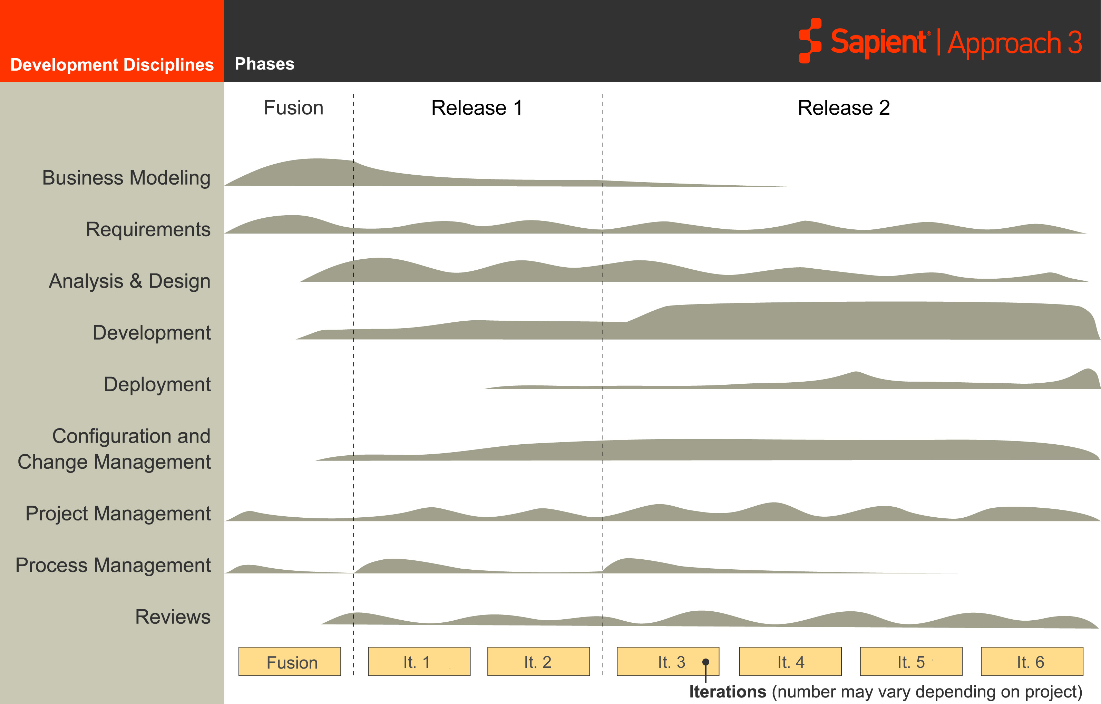
S|A 3 Project Life Cycle
Sapient|Approach 3
Fusion
EAR
Release 2
Requirements gathering occurs throughout the project life cycle

Slide 3

Requirements
Activities
Mandatory Artefacts

Slide 4
Requirement Activities
Analysis & Design
Configuration Management
Project Management
Development
Develop Vision
Project Management
Create Use Case Model
Requirements
Detailed Product Requirements
Reviews
Manage Traceability

Slide 5


Develop Vision
Purpose:
  Establish a shared vision of the solution with all stakeholders
Objectives:
  Define the problem statement describing the fundamental 'why' and 'what' of the project
  Define the Measurable Business Results (MBRs) of the project
  Identify the list of key solution features which come from the top needs of the stakeholders
Activities:
  Identify stakeholders of the solution
  Establish agreement on the underlying problem statement to define the purpose of the project
  Establish a list of high level requirements in form of a features list, based on the benefits listed in the problem statement
  Define MBRs
Mandatory Artefact:
  Vision document

Slide 6

Create Use Case Model
Purpose:
  Gain common understanding of the functional requirements
Objectives:
  Model solution requirements to an appropriate level of detail using use cases
  Leverage user-centric techniques to improve understanding of solution requirements
Activities:
  Create use cases at the Basic level using Use Case templates - breadth first
  Progressively add detail (moving to more detailed use case templates) as needed using Use Case templates - depth
    Level of detail required is driven by risk
Mandatory Artefacts:
  Basic Use Cases
  Detailed Use Cases
  Fully Dressed Use Cases

Slide 7
Detail Product Requirements
Purpose:
  Detail out Client’s Functional or Non-Functional Requirements as necessary to support the solution
Objectives
  Accurately capture the current understanding of product requirements
  Document/update requirements using supporting materials such as use case documents, style guides, wireframes, policies, standards and other materials as needed
Activity
  Capture requirements in Scope Matrix
  Prioritise requirements by business value and technical risk
  Create references to supporting materials
  Review and close requirements with clients
Artefacts:
  Scope Matrix
  List of Use Cases
  Non-functional Requirements
Notes:
Speaker notes:
The Scope Matrix will still be used. In future releases of RS, you will be able to put this information into the online Planning Tool.

Slide 8
Exercise

Slide 9

Exercise: Book Hotel Background
Book Hotel Vision Statement
  Build a hotel booking web based engine that competes with Hotels.com to be brought to market as quickly as possible
Book Hotel Features List
  High quality pictures of hotel facilities
  Detailed information on hotel amenities
  Flexible search capabilities
  ….
Notes:
Speaker notes:
This basis for this example comes from a real Sapient project that we are in the process of piloting.
Intent of feature is to decribe the business problem that the solution will address.

Slide 10
Exercise: Book Hotel Requirements
What you need to do:
  Brainstorm some basic use cases associated with Book Hotel
  Identify which use cases might be good candidates for exploring in more detail?

Slide 11
Exercise: Book Hotel Requirements Use Case Examples
Search for a hotel
Book a hotel
Email hotel information to a friend
Check availability of hotels
Print hotel information
…
Notes:
Speaker notes:
These are some examples, there are many more that do not appear here.

Slide 12
Manage Traceability
Purpose:
  To ensure that all requirements have been fulfilled, and that all development efforts are associated with actual client requirements
Objectives:
  Ensure complete and accurate decomposition of features into requirements
  Ensure that all requirements of the system are fulfilled by implementation artefacts (code, tests)
  Support changing requirements through rapid assessment of impacts associated with changes
  Balance requirements and eliminate contradictions
Activities:
  Establish traceability
  Maintain traceability
  Review traceability matrix with client
Mandatory Artefact:
  Traceability Matrix

Slide 13
Traceability Example
Simple Booking Process
Stakeholders Needs
Provide Rich Content
High quality pictures of hotel facility
Flexible Search Capabilities
Detailed information on Hotel amenities
Features
Use Cases
Search for a Hotel
Book a Hotel
Advanced Search based on Location, # days, # guests, date
Wire Frames for Search
Simple Search based on Location
Stories
TestSimpleSearch.java
Tests

Slide 14
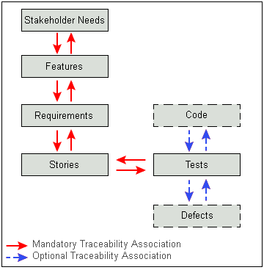
Manage Traceability
Choose an appropriate traceability model for your project
Managing Traceability without automation quickly becomes very time consuming.
In ResultSpace, the ability to associate requirements to other project artifacts and to generate traceability reports is planned as a future enhancement

Slide 15
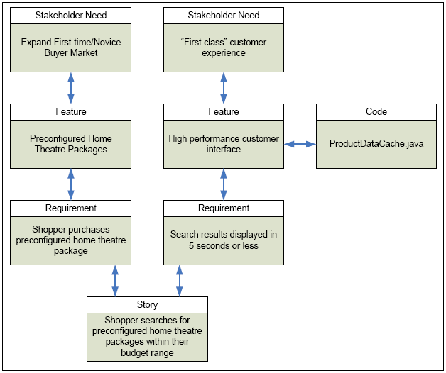
What’s wrong?
Notes:
Speaker Notes:
Code should not be associated with Feature. Code should be associated with Story.

Slide 16
Requirements
Activities
Mandatory Artefacts

Slide 17
Mandatory artefacts: Requirements
Vision document
Use case model
Use cases
  Basic
  Detailed
  Fully Dressed
Service Level Agreement (for Manage projects only)
Requirements database (work in progress)
  Scope Matrix
  Traceability Matrix

Slide 18
Questions?

